Slide 1
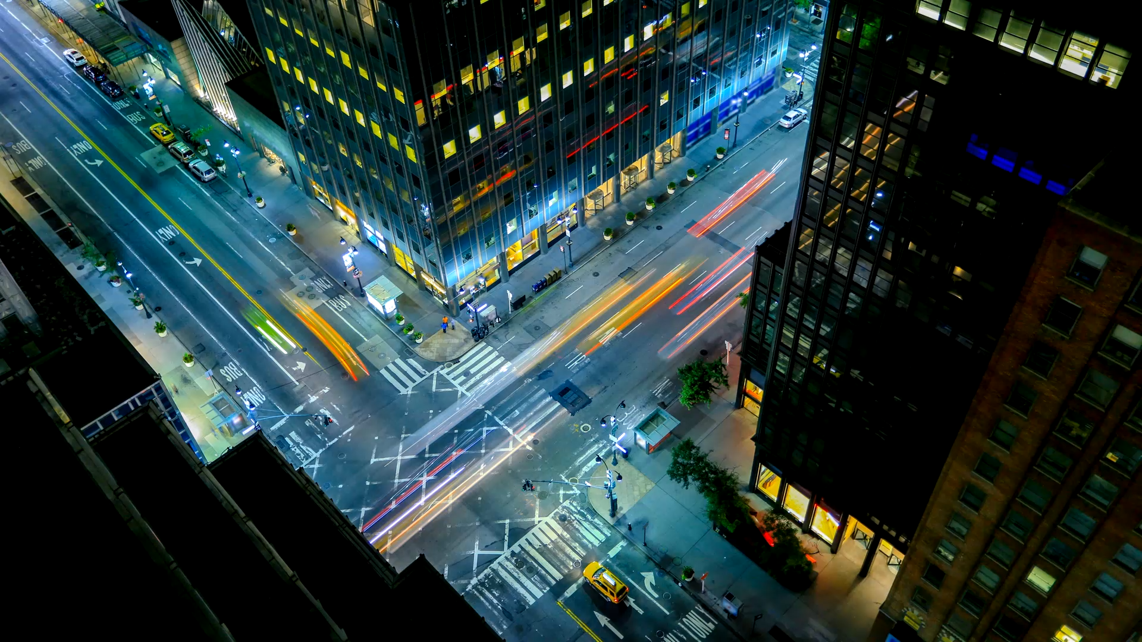
New York City Taxis

Slide 2


INTRODUCTION
1.1 Billion taxi rides from 2009-2015.
Approximately 150,000 taxis and for-hire vehicles in 2015.

Slide 3
Understanding the customer
What does a life of an average new yorker look like?

Slide 4
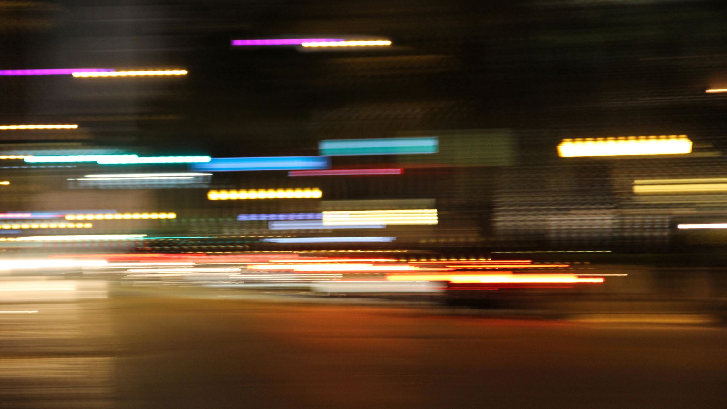
Hypothesis: Life story of bob
Does not own a car.
Has a 9-5 job in the city on weekdays.
Friday night party.
Meet-ups with friends on Saturday and has a nice Sunday Brunch .
Occasionally rides to the airport.

Slide 5
Does our data support it?
Let us dive further.

Slide 6
Stay in the city
Why?
When?
Where?

Slide 7
Clients Needs
Habits
Convenience

Slide 8
Travelling to the airport ?
Check the flight status
Offers better alternatives to rate code
More tips
Easy rides

Slide 9
Summary
Weekday:
7 am – 2pm
8(Harlem), 2 (E 21st St), 16 (W 50th St), 0(Grand Central Station)
6pm – 10 pm
8(Harlem), 0(Grand Central Station), 2(E 21st St)
Midnight
8(Harlem), 16(W 50th St), 0(Grand Central Station)
Weekend
Midnight
2(E 21st St), 8, 15(E 3rd St), 16(W 50th St)
Day
15(E 3rd St), 2(E 21st St)
All Night
16(W 50th St), 17(E 74th St), 0(Grand Central Station)

Slide 10
Summary
Early Start at 5 am
Pick up a customer from the airport and move to rush hour
Starting after rush hour in the evening
Pick up a customer from the airport and move to midnight clusters

Slide 11

Thank you

